Slide 1
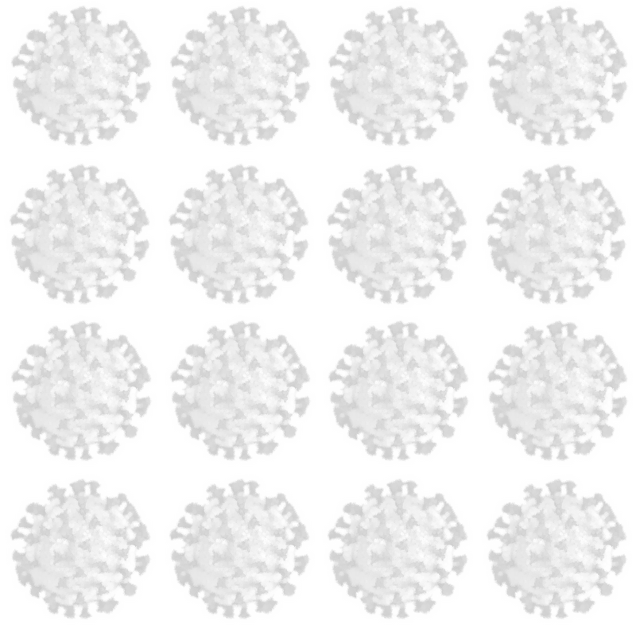
OpenReader

Slide 2
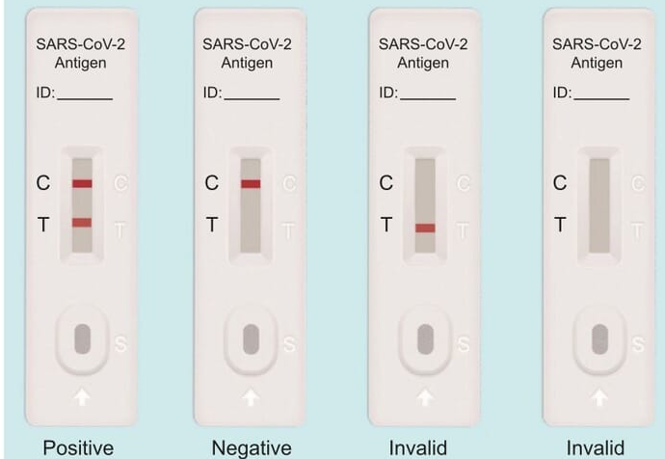
• Qualitative
• Manual

Slide 3
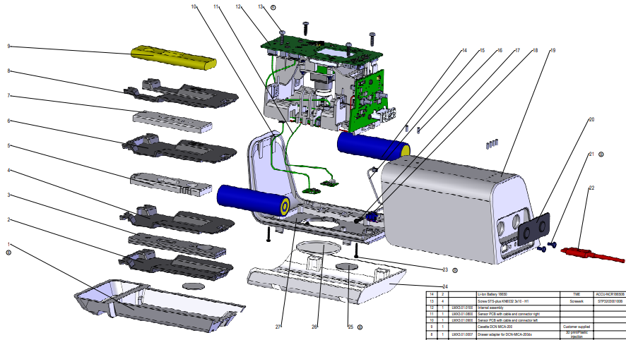
Quantitative, image analysis-based antigen test reader

Slide 4
Coding Part
• Image Analysis
• Embedded System

Slide 5
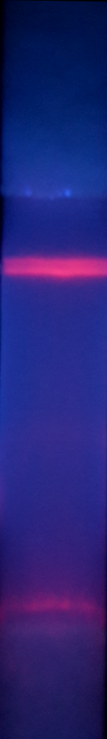
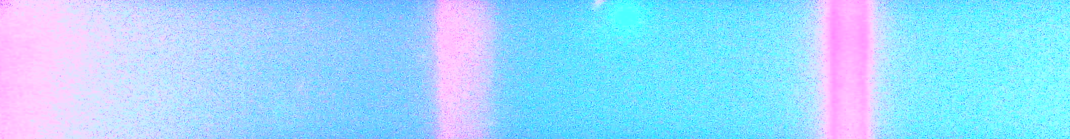
Image Analysis
• Identify the strips (width, center)
• Locate the peaks
• Fit into a gaussian on a slope

Slide 6
Hardware and Embedded system
• Communicate with the camera and chip
• Maintenance and security
• Compilation of the code on the system

Slide 7
What do we have to do?

Slide 8
What do we have to do?
Software Team
5 people
Hardware Team
10 people

Slide 9
What do we have to do?
Software:
MATLAB side
Warm up: understand what’s going on.
Then:
Streamlining the program for deployment.
Rewriting to allow automatic conversion. (encapsulation, appropriate hooks)
…
Experiment with different fit parameters, image de-noising heuristics, more sophisticated summary results

Slide 10
What do we have to do?
Software:
C++ side
Hooking up the the generated library and actually using it.
…
Implementing the parts that it is more sensible to rewrite manually (eg: logging).
…
Rewrite interface for lab work

Slide 11
What do we have to do?
Software:
Final result:
It should be possible to modify the algorithm logic in MATLAB and recompile without breaking anything

Slide 12
What do we have to do?
Harware:
Foreplay:
creating a dependency list for the current code and an installer. Get it to compile.
understanding what the current code does
what hardware we are dealing with?
How do we upload code to the machine?

Slide 13
What do we have to do?
Harware:
Main dish:
Implementing safety features
Implementing maintenance checks
Adapting the machine – smartphone and machine – desktop communication.
Automating the upload pipeline as much as possible.
Adding functionalities
…
Extend (write?) the driver for the camera

Slide 14
What do we have to do?
Everyone all the time:
Write a decent documentation with GitHub Wiki

Slide 15
Final result:
A functioning device.

